Slide 1
THE RELATIONAL DATABASE MODEL
Database Concepts Spring 2021
Week 4

Slide 2
Relationships within the Relational Database
1:M relationship - Norm for relational databases
1:1 relationship - One entity can be related to only one other entity and vice versa
Many-to-many (M:N) relationship - Implemented by creating a new entity in 1:M relationships with the original entities
Composite entity (Bridge or associative entity): Helps avoid problems inherent to M:N relationships, includes the primary keys of tables to be linked
Notes:
A many-to-many (M:N) relationship is not supported directly in the relational environment.

Slide 3

The 1:M Relationship

Slide 4
The 1:M Relationship
The one-to-many (1:M) relationship is easily implemented in the relational model by putting the primary key of the “1” side in the table of the “many” side as a foreign key.
Notes:
Tables are related to each other through the sharing of a common attribute.

Slide 5
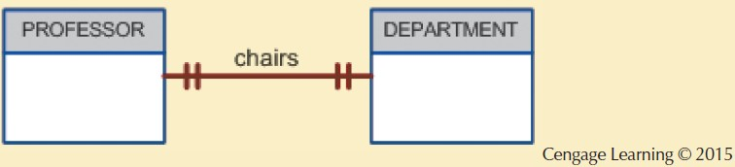
The 1:1 Relationship
Select the FK that causes fewest Null
Notes:
A professor can chair only one department, and one department can have only one department chair.

Slide 6
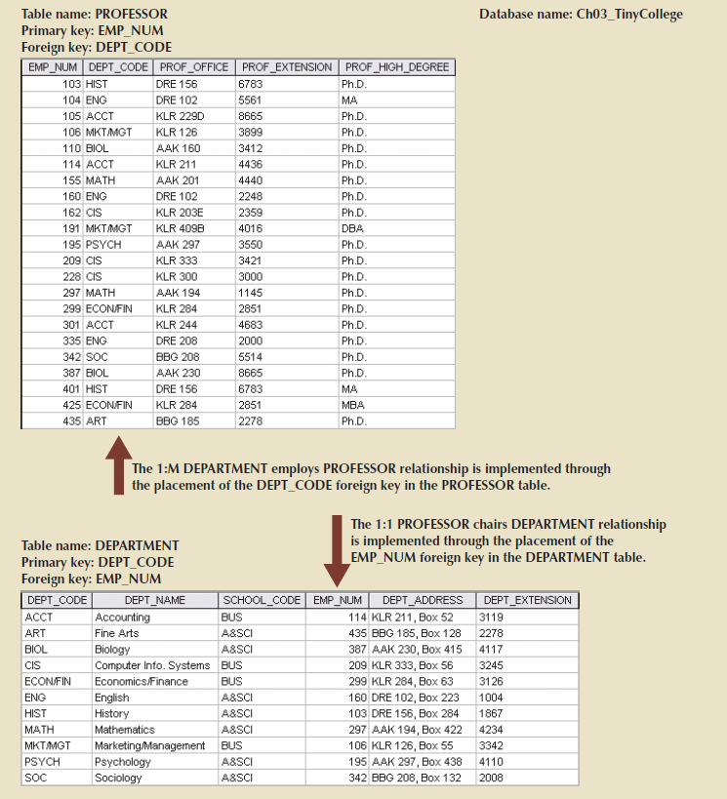
The 1:1 Relationship
Notes:
The 1:1 “PROFESSOR chairs DEPARTMENT” relationship is implemented by having the EMP_NUM foreign key in the DEPARTMENT table.

Slide 7
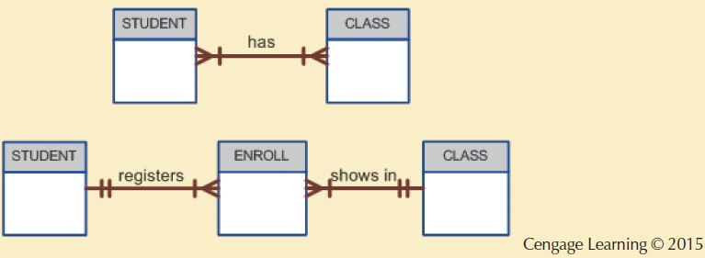
Fig. 3.26: Changing the M:N Relationship to Two 1:M Relationships

Slide 8
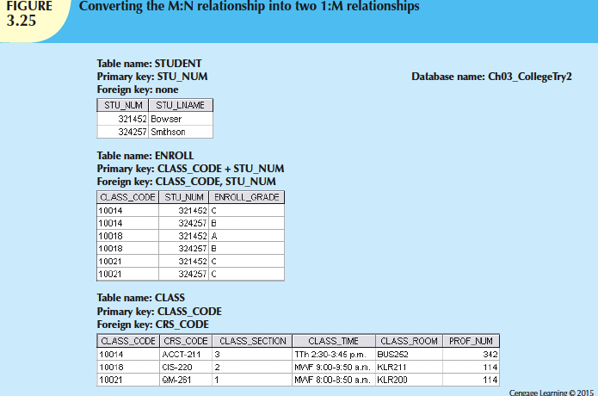
Notes:
In this example, the ENROLL table’s primary key is the combination of its foreign keys CLASS_CODE and STU_NUM. (However, the designer could have decided to create a single-attribute new primary key such as ENROLL_LINE, using a different line value to identify each ENROLL table row uniquely. ) Because the ENROLL table links two tables, STUDENT and CLASS, it is also called a linking table. In other words, a linking table is the implementation of a composite entity.

Slide 9
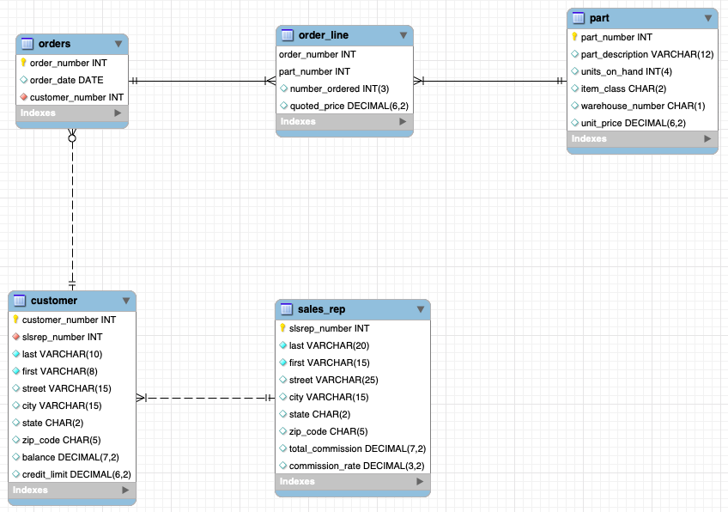

Slide 10
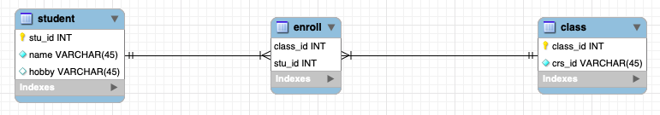
Notes:
A student can enroll on one to may class and a class can be enrolled by one to may students.

Slide 11
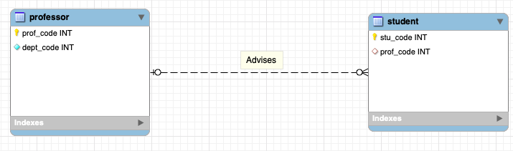

Slide 12
Data Redundancy
Relational database facilitates control of data redundancies through use of foreign keys (common attributes shared by tables)
To be controlled except the following circumstances
Data redundancy must be increased to make the database serve crucial information purposes
Exists to preserve the historical accuracy of the data

Slide 13
Data Dictionary
Data dictionary: Description of all tables in the database created by the user and designer
“the database designer’s database” : it records the design decisions about tables and their structures. The data dictionary contains at least all of the attribute names and characteristics for each table in the system. In short, the data dictionary contains metadata-data about data.
See page #92 in Chapter 3.
Homonyms and synonyms must be avoided to lessen confusion
Homonym: Same name is used to label different attributes
Synonym: Different names are used to describe the same attribute

Slide 14
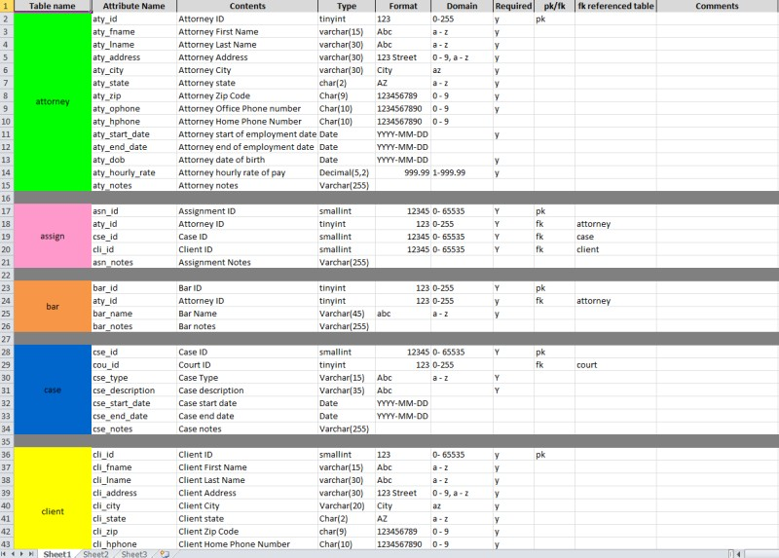

Slide 15
Relational Algebra
Theoretical way of manipulating table contents using relational operators

Slide 16
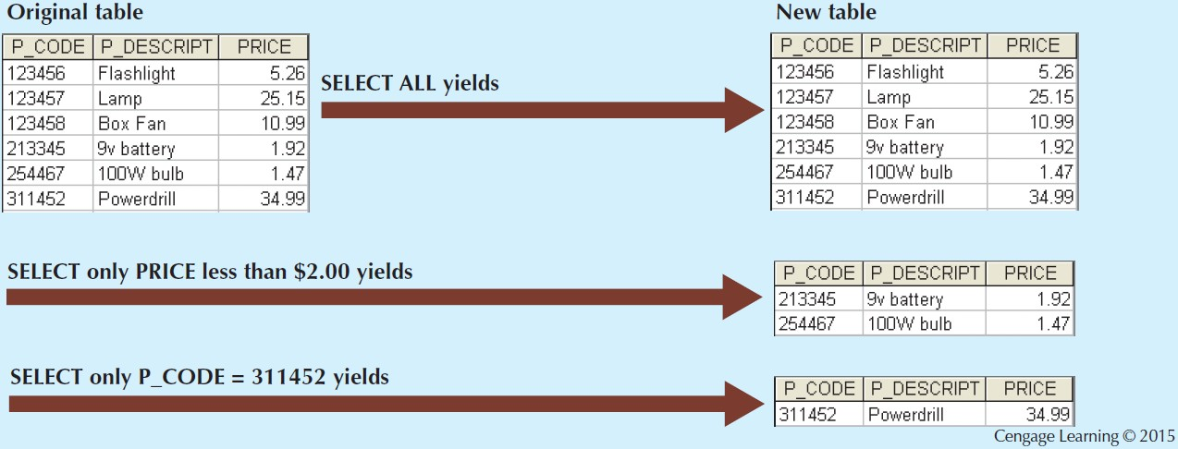
Figure 3.4 - Select
Notes:
SELECT, also known as RESTRICT, is referred to as a unary operator because it only uses one table as input. SELECT can be used to list all of the rows, or it can yield only rows that match a specified criterion.

Slide 17
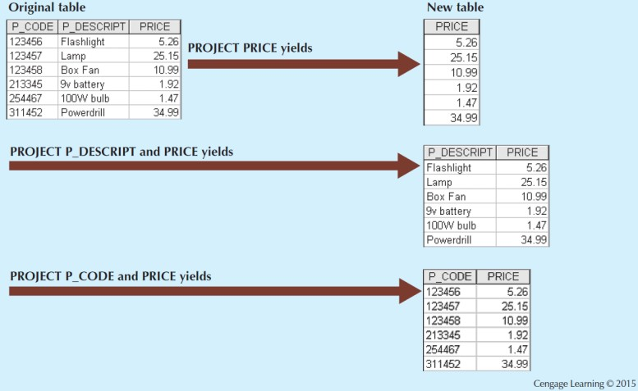
Figure 3.5 - Project
Notes:
PROJECT yields all values for selected attributes. It is also a unary operator, accepting only one table as input. PROJECT will return only the attributes requested, in the order in which they are requested.

Slide 18
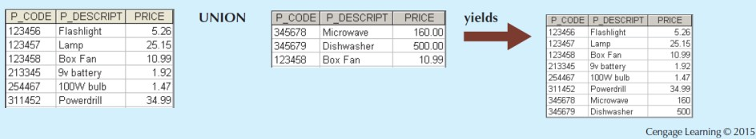
Figure 3.6 - Union
Union-compatible
In order for two relations to be union-compatible, both must have the same
number of attributes (columns) and corresponding attributes (columns) must have the same domain.
The Product, Join, and Divide operators can be applied to a pair of tables that are not union-compatible.
Notes:
UNION combines all rows from two tables, excluding duplicate rows. To be used in the UNION, the tables must have the same attribute characteristics; in other words, the columns and domains must be compatible.

Slide 19
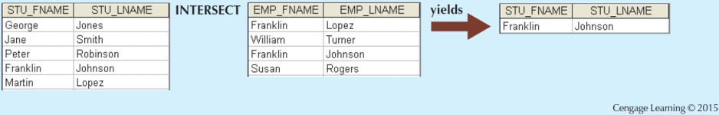
Figure 3.7 - Intersect
Notes:
INTERSECT yields only the rows that appear in both tables. As with UNION, the tables must be union-compatible to yield valid results

Slide 20
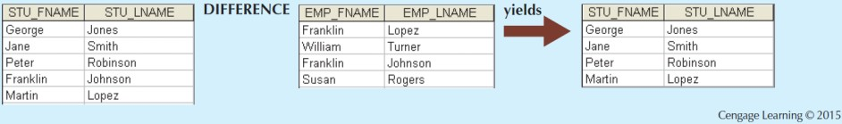
Figure 3.8 - Difference
Notes:
DIFFERENCE yields all rows in one table that are not found in the other table; that is, it subtracts one table from the other. As with UNION, the tables must be union-compatible to yield valid results. Note that subtracting the first table from the second table is not the same as subtracting the second table from the first table.

Slide 21
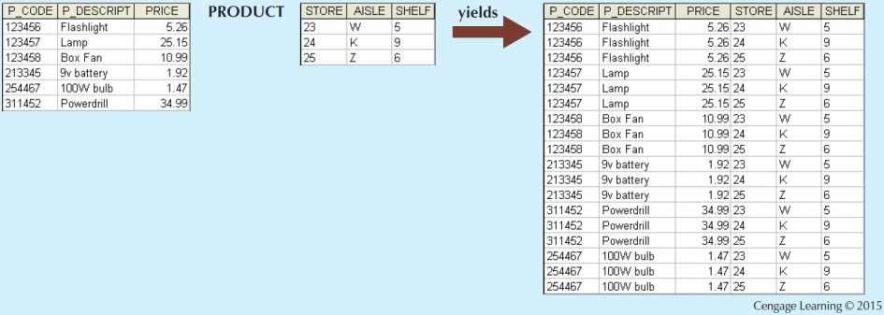
Figure 3.9 - Product
Notes:
PRODUCT yields all possible pairs of rows from two tables—also known as the Cartesian product. Therefore, if one table has six rows and the other table has three rows, the PRODUCT yields a list composed of 6*3=18 rows.

Slide 22
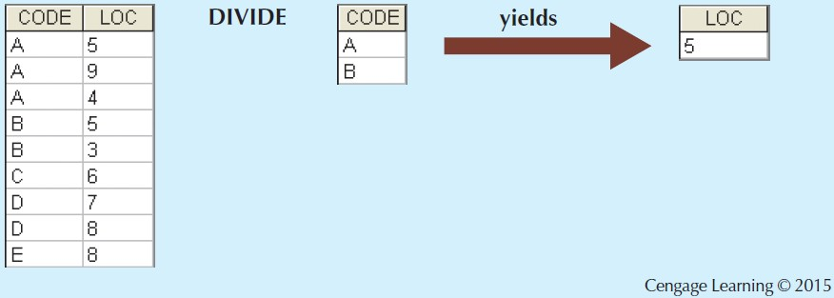
Figure 3.16 - Divide
Notes:
The DIVIDE operation uses one 2-column table as the dividend and one single-column table as the divisor. The output of the DIVIDE operation is a single column that contains all values from the second column of the dividend (LOC) that are associated with every row in the divisor.

Slide 23
Types of Joins
Inner join: Only returns matched records from the tables that are being joined
Natural join: Links tables by selecting only the rows with common values in their common attributes (without duplicate columns)
Join columns: Common columns
Equijoin: Links tables on the basis of an equality condition that compares specified columns of each table (with duplicate columns)
Outer join: Matched pairs are retained and unmatched values in the other table are left null
Left outer join: Yields all of the rows in the first table, including those that do not have a matching value in the second table
Right outer join: Yields all of the rows in the second table, including those that do not have matching values in the first table
Notes:
A natural join links tables by selecting only the rows with common values in their common attribute(s). The final outcome of a natural join yields a table that does not include unmatched pairs and provides only the copies of the matches.
An equijoin links tables on the basis of an equality condition that compares specified columns of each table. The outcome of the equijoin does not eliminate duplicate columns.
The labels ‘left’ and ‘right’ refer to the order in which the tables are listed in the SQL command.

Slide 24
Joins

Slide 25
Natural Join
Notes:
A natural join links tables by selecting only the rows with common values in their common attribute(s). A natural join is the result of a three-stage process:
First, a PRODUCT of the tables is created, yielding the results shown in Figure 3.11.

Slide 26
Natural Join
Notes:
Second, a SELECT is performed on the output of Step 1 to yield only the rows for which the AGENT_CODE values are equal. The common columns are referred to as the join columns. Step b yields the results shown in Figure 3.12.
This is equijoin with duplicated columns.

Slide 27
Natural Join
Notes:
Finally, A PROJECT is performed on the results of Step 2 to yield a single copy of each attribute, thereby eliminating duplicate columns. Step 3 yields the output shown in Figure 3.13.
Another form of join, known as an equijoin, links tables on the basis of an equality condition that compares specified columns of each table. The outcome of the equijoin does not eliminate duplicate columns. In fact, the result of an equijoin looks just like the outcome shown in Figure 3.12 for Step 2 of a natural join.

Slide 28
Left Outer Join
Notes:
A left outer join yields all of the rows in the CUSTOMER table, including those that do not have a matching value in the AGENT table. An example of such a join is shown in Figure 3.14.

Slide 29
Right Outer Join
Notes:
A right outer join yields all of the rows in the AGENT table, including those that do not have matching values in the CUSTOMER table. An example of such a join is shown in Figure 3.15.
Outer joins are especially useful when you are trying to determine what values in related tables cause referential integrity problems. Such problems are created when foreign key values do not match the primary key values in the related table(s).

